Slide 1
JOB APPLICATION TRACKING SYSTEM
Project Application Experiential Learning Program
Team Lead :S.Jeyasri
Team Member 1: R.Abinaya
Team Member 2: S.Devi
Team Member 3: V. Kavinila

Slide 2
INTRODUTION
OVER VIEW:
An Job Application Tracking system is software
for recruiters and employers to track candidates throughout the recruiting and hiring process.

Slide 3
PURPOSE
An job ATS creates opportunities to automate manual processes.
Increase visibility into the hiring cycle for the entire recruiting team.
Increase opportunities for communication throughout the candidate journey.

Slide 4
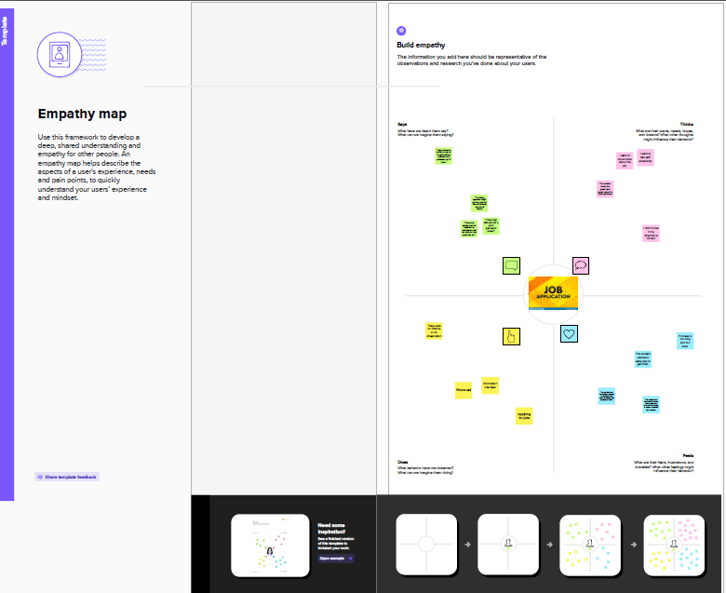
PROBLEM DEFINITION AND DESING THINKING
Empathy map

Slide 5
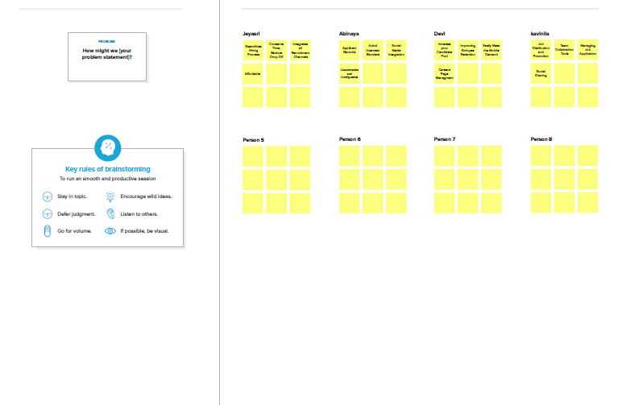
BRAINSTORMING

Slide 6
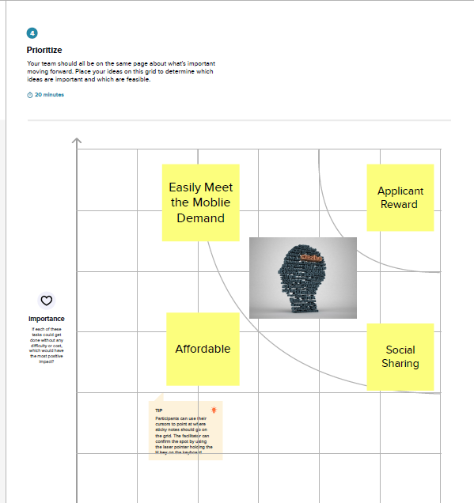
MAP

Slide 7
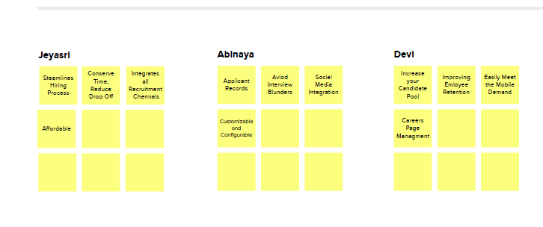
BRAINSTORMING

Slide 8
RESULT
OBJECT NAME | FIELD IN THE OBJECT
1.Recruiter | FILED LABLE | DATA TYPE
 | Recruiter | Auto Number
2.Candidate | FILED LABLE | DATA TYPE
 | Candidate | Auto Number
3.Tab | FILED LABLE | DATA TYPE
 | Tab | Auto Number
4.Job Title | FILED LABLE | DATA TYPE
 | Job Title | Text(30)

Slide 9
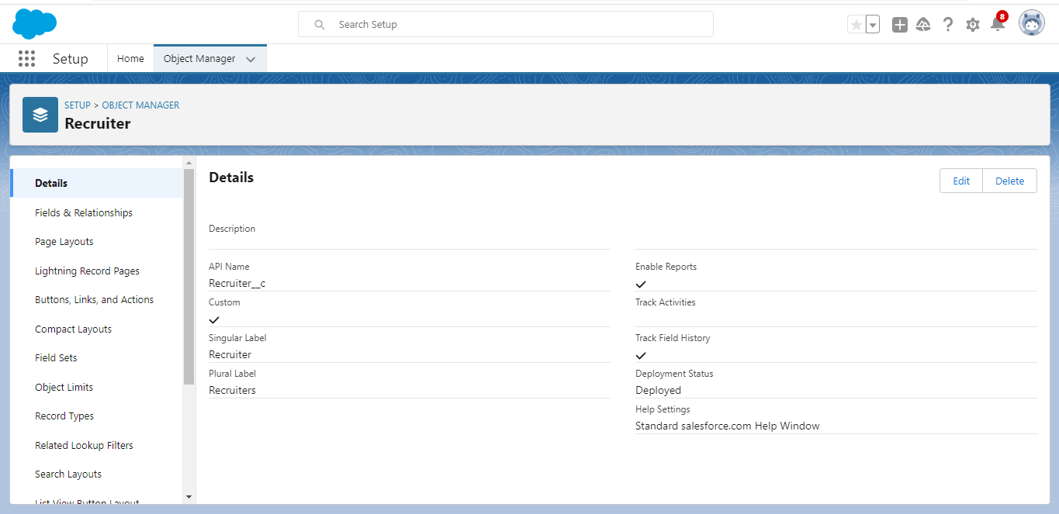
ACTIVITY

Slide 10
Description:
Activities include tasks, events, and calendars.

Slide 11
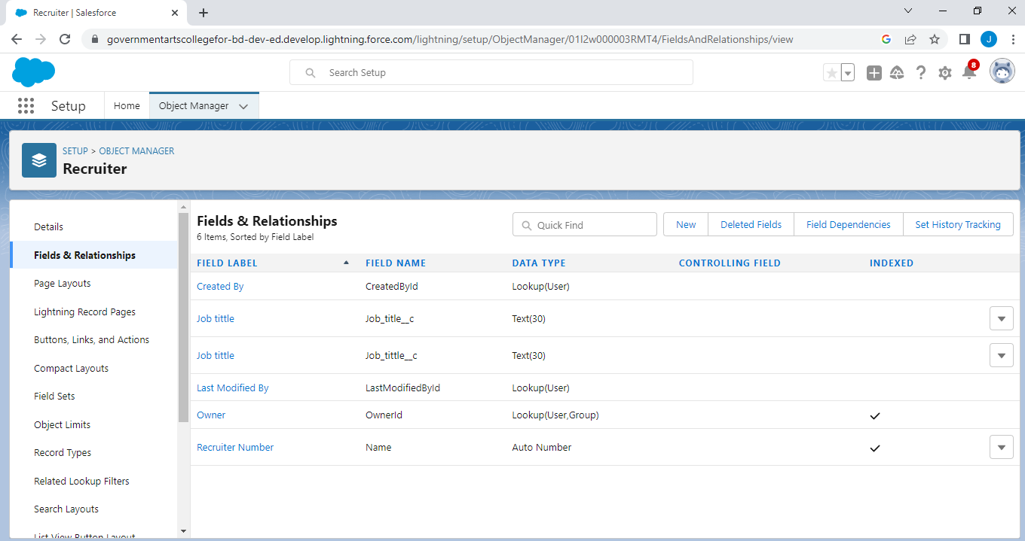
RECRUITER

Slide 12
Description:
Recruiting delivers personalised candidate experiences at scale driving engagement and loyalty

Slide 13
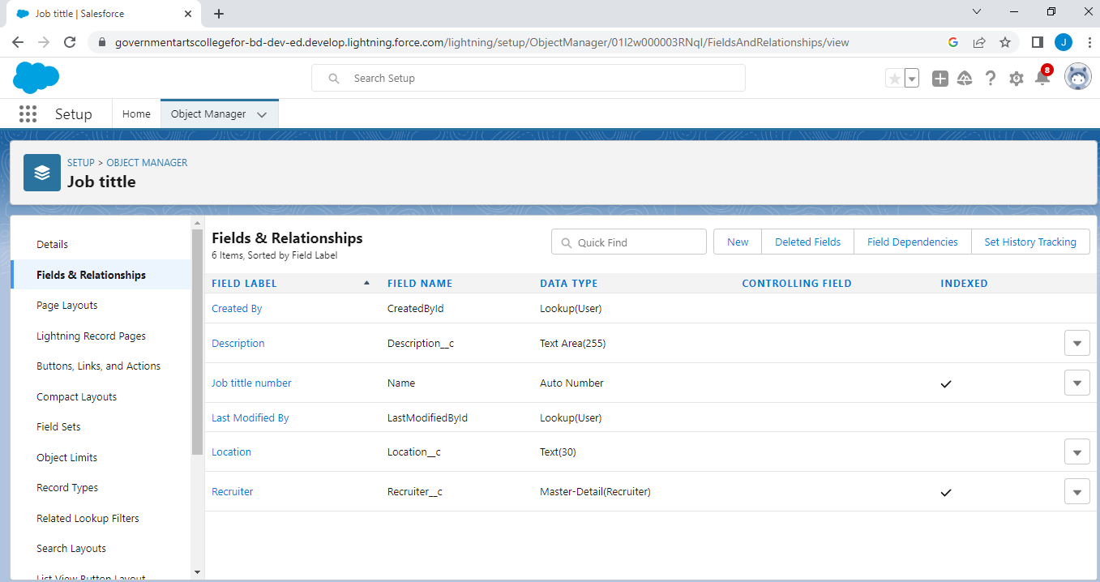
JOB

Slide 14
Description:
A developer is a person who works on building applications using CRM software in various organizations

Slide 15
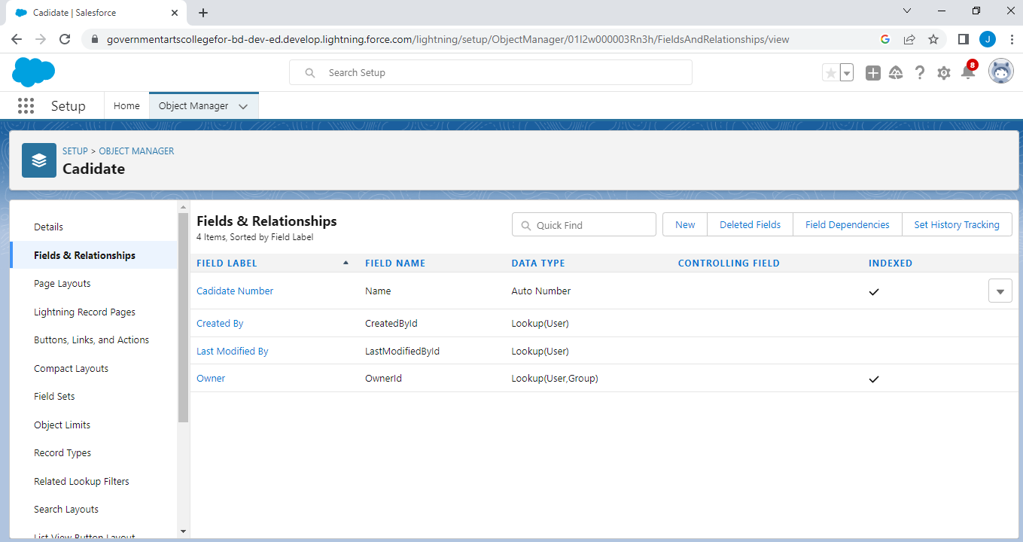
CANDIDATE

Slide 16
Description:
The Candidates Quick Action is used to find qualified Service Resources

Slide 17
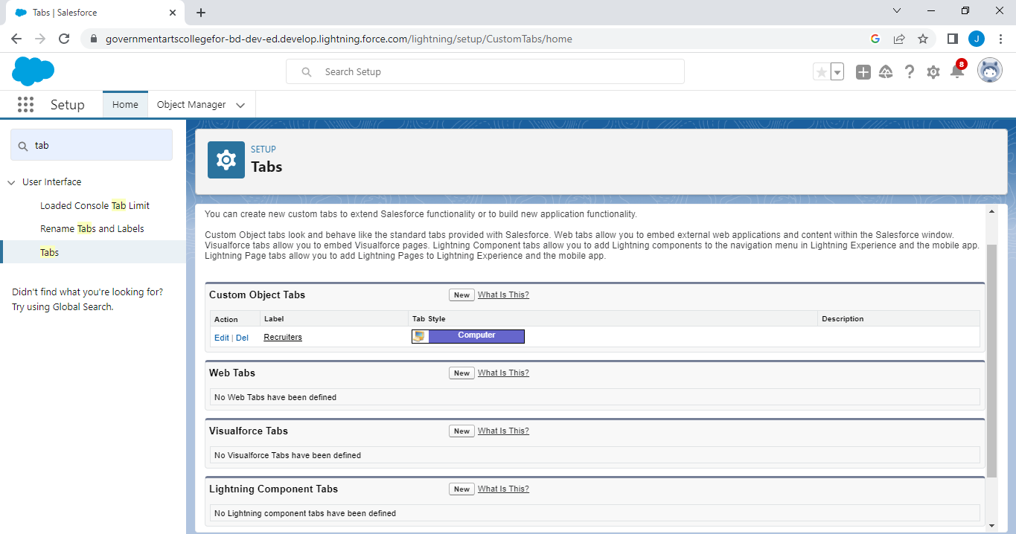
TAB

Slide 18
Description:
A user interface that is used to build records for objects and to view the records in the objects.

Slide 19
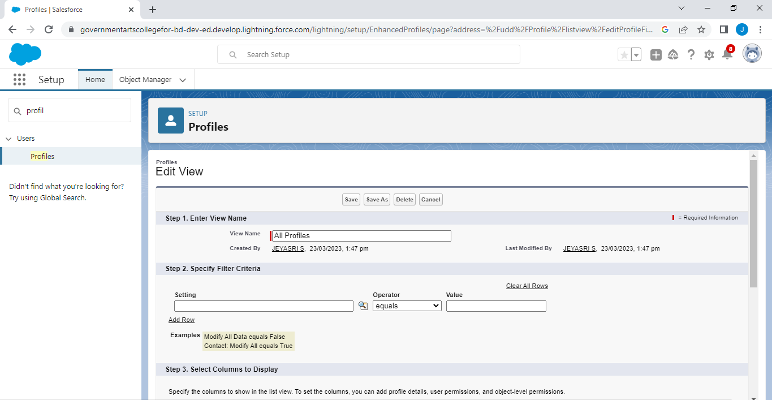
PROFILE

Slide 20
Description:
User profiles decide which objects and data they have access to.

Slide 21
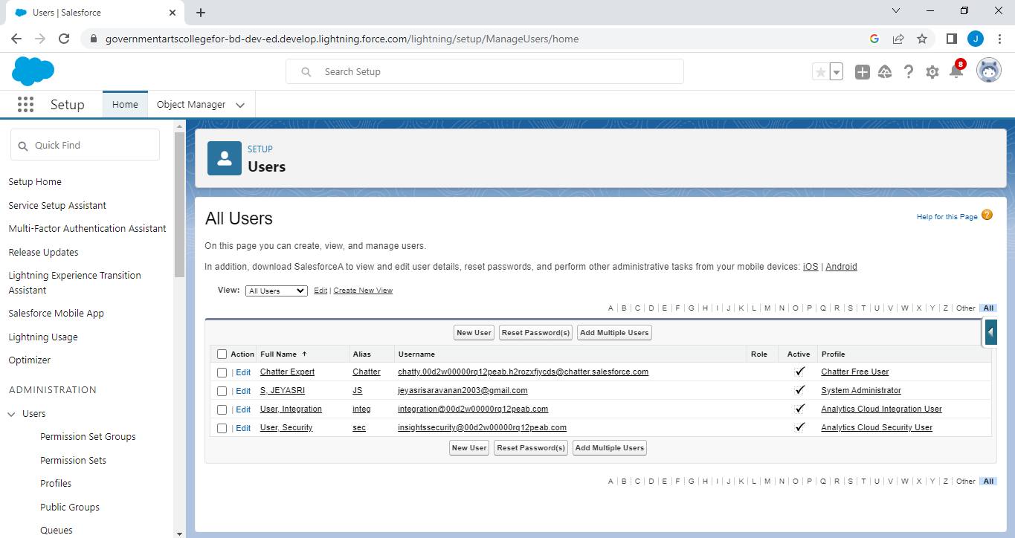
USER

Slide 22
Description:
A user is anyone who logs in to . Users are employees at your company, such as sales reps,

Slide 23
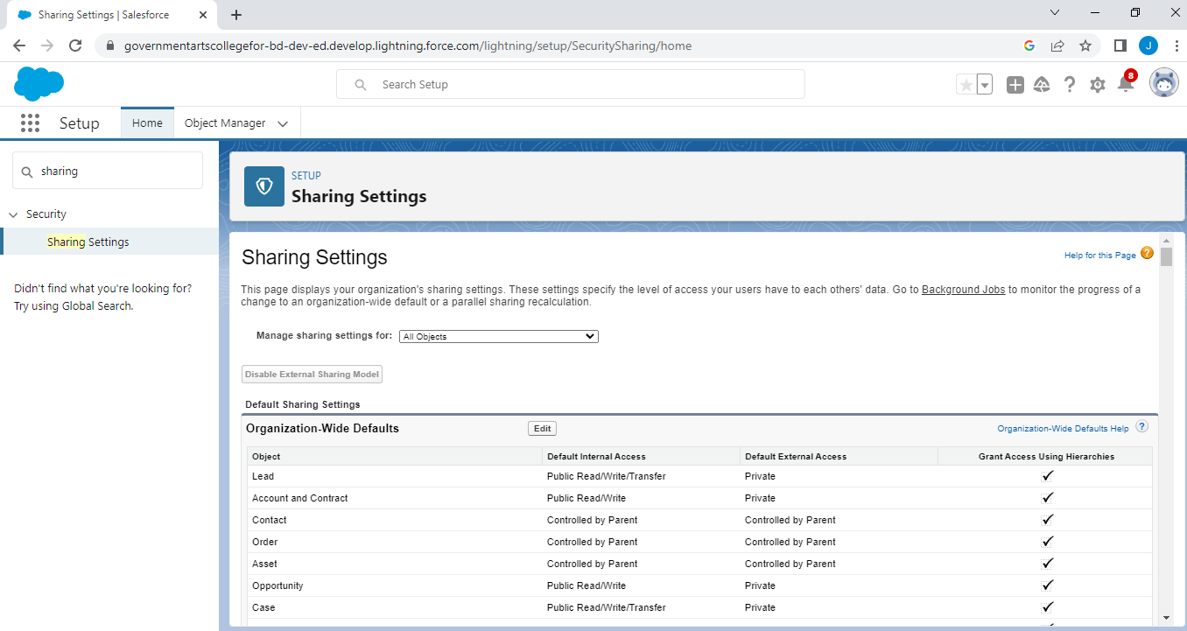
SHARING SETTINGS

Slide 24
Description:
You can control access to data at many different levels.

Slide 25
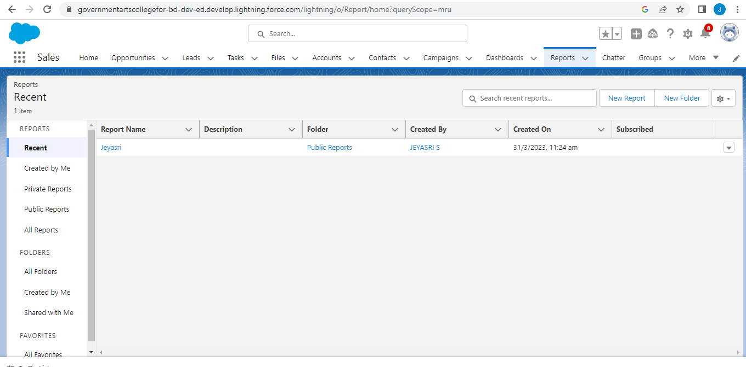
REPORTS

Slide 26
Description:
A report is a list of records that meet the criteria you define. It's displayed in rows and columns.

Slide 27
TRAILHEAD PROFILE
Team Lead- https://trailblazer.me/id/jeyas38
Team Member1- https://trailblazer.me/id/abinr10
Team Member2- https://trailblazer.me/id/devis66
Team Member3- https://trailblazer.me/id/kaviv25

Slide 28
ADVANTAGES
Reduces time spent with administrative tasks.
Facilitates collaborative hiring.
Improves the quality of hire.
Boots employer brand.

Slide 29
DISADVANTAGES
ATS is missing qualified applicants due to wrong keyword selection.
An ATS is that they are open to manipulation.
Automatic elimination of resumes that software cannot recognize interpret is another drawback of ATS.

Slide 30
APPLICATIONS
Application History.
Contact Information.
Communication History.
Resume.
Lower cost per hire.

Slide 31
CONCLUSION
Job Application Tracking System for recruiters is very effective hiring solution that most of the successful recruiters utilize .Because without it , there is good chance that your process of moving applicants through different stages can become very difficult.

Slide 32
FUTURE SCOPE
User friendly.
Social network.
Mundane tasks.

